Slide 1
Foxlink India Website Content
www.foxlinkindia.in

Slide 2
Agenda-1
Home
Why Foxlink
About company
Foxlink Group
Foxlink India
Foxlink’s Strategy:
Foxlink unique features
Foxlink India location
Foxlink Facility overview
Office overview
Utility facilities overview
Cable Assembly line-Overview
SMT Assembly line-Overview
SMT Line Machine specification
PCBA In-house Testing Facility
Quality Certification

Slide 3
Agenda-2
Current Products
Lightening Cable Assembly
Type C-Cable Assembly
SMT Service
Upcoming products
FATP
Wearable Device
TWS, Headphone
Power Adapter
Power Bank
Injection Molding

Slide 4
Home

Slide 5

Home Screen-Scrolling Image-1
35 Years of experience in consumer electronics field & Automotive

Slide 6
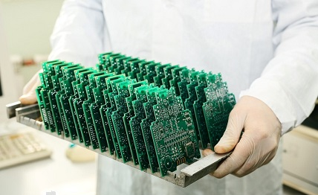
Home Screen-Scrolling Image-2
Complete PCBA full solution provider

Slide 7
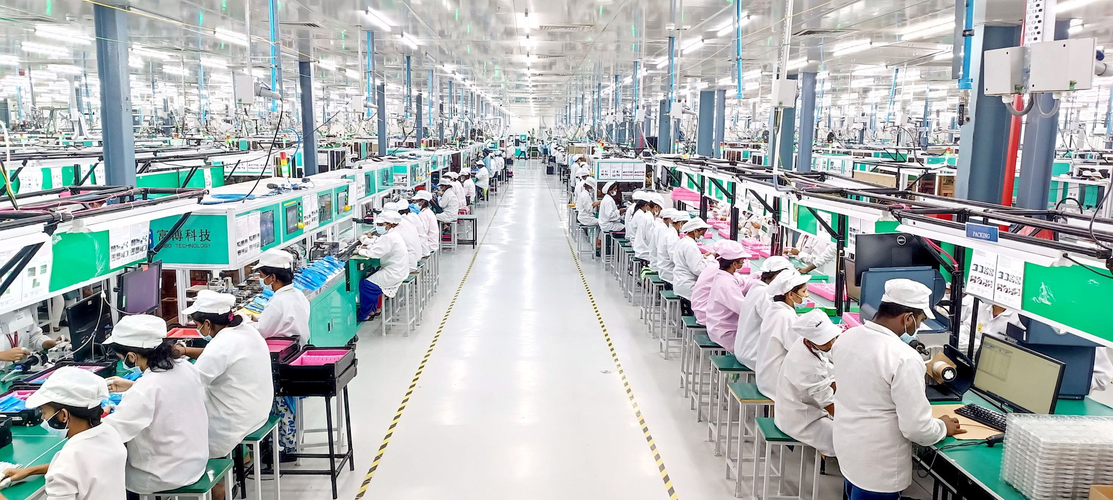
Home Screen-Scrolling Image-4
Type-C Cable Full Automated Assembly

Slide 8
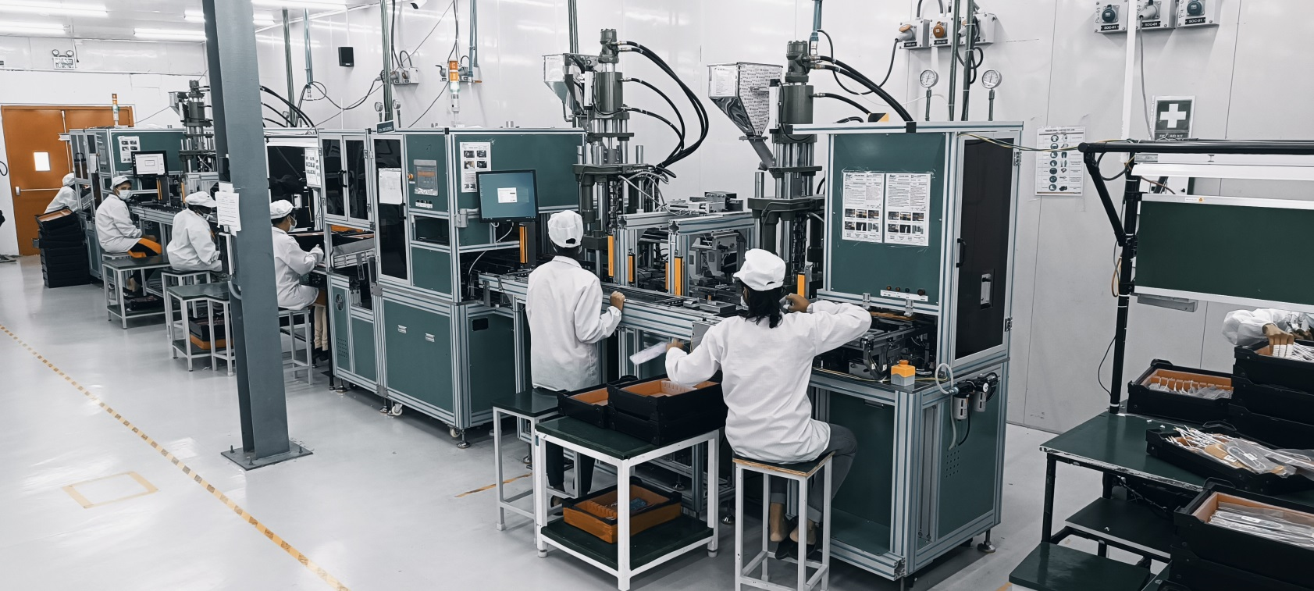
Home Screen-Scrolling Image-6
Production line

Slide 9
Why Foxlink
With current high speed facilities, We are the best in Top 5 EMS players in India in term of R&D capability, capacity
From 2020, Foxlink is focusing on providing electronics manufacturing service with design and technology support to entire spectrum of Indian Electronics industry like consumer electronics, Automotive, Defence etc.,
Foxlink Global Footprints: USA/INDIA/ MYANMAR/TAIWAN
Foxlink is focusing specially on India Emerging Market with design ,technology support to have “Make in India”
Foxlink has world class SMT Equipment's with all accessories to handle any kind of active and passive SMT components, including most odd shape components
For India’s most demanding applications, the best in class equipment like Solder pasting printing, Solder paste inspection, Reflow, AOI before and after reflow, customer specific testing facilities, X Ray inspection are available with Foxlink
We already placed Senior engineers for local in Tirupathi for localizing and leveraging our global group technology and 35 years of experience

Slide 10
About company

Slide 11
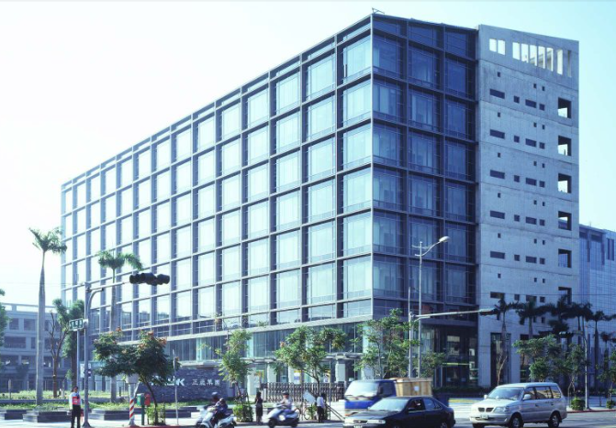
About Foxlink Group
About Foxlink Group:
Foxlink Group Established in 1986
Headquarters: Taipei, Taiwan
Group Turnover-＄89.5 billion NTD(23,538 Cr in INR)
30,835 Employees around group
35 Year of experience
17% Compound Annual Growth Rate
Diversified product portfolio in consumer electronics industry, Automotive industry

Slide 12
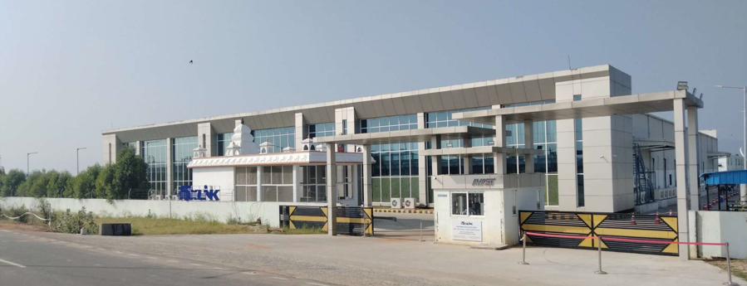
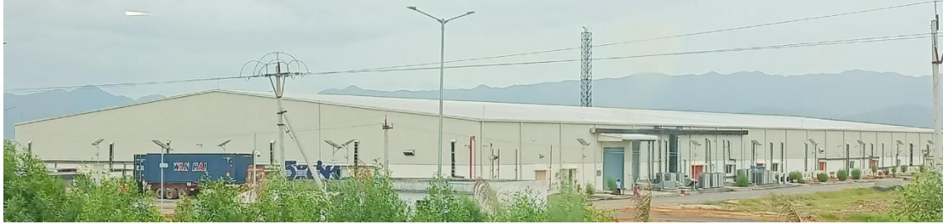
About Foxlink India
About Foxlink India:
Plant Incorporated in 2020 & Located in Tirupathi
Production
Cable Assemblies(with closed air condition)
Inhouse PCBA-SMT Assemblies
ISO 9001, 14001, 45001, certified
Dorm Hostel – Facilitated to our Ladies Employees

Slide 13
Foxlink’s Strategy:
From India to World
Make in India
Bring global technology to India of global foot prints
Localization of import from china
Exclusive laborites for testing and function at each production line

Slide 14
Foxlink India Unique Service
Foxlink Global Footprints: USA/INDIA/ MYANMAR/TAIWAN/CHINA
Government Incentives: SPECS/ IGCR/ WEARABLES/SEMICON/EV/SMT
Bonded Warehouse , MOOWR
Localization & Vertical Integration of Latest Technology
This slide not needed and remove from website

Slide 15

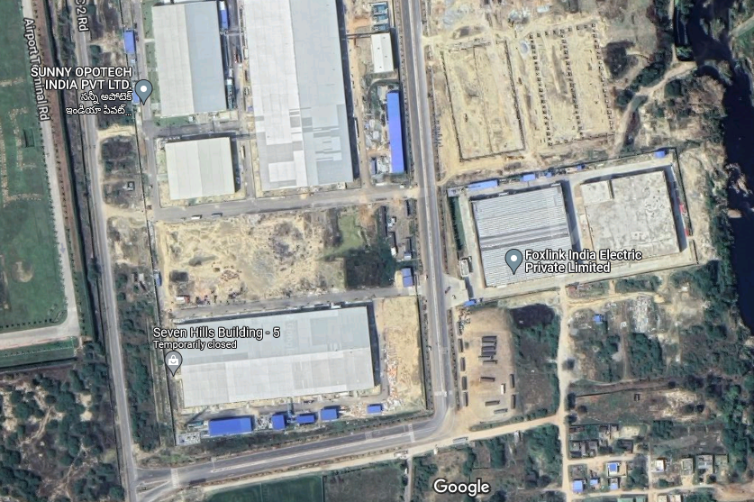

Foxlink India Presence:
Closer proximity to customers
Tirupathi plant unique features
Noida
(Land acquired)
New details are added in this slide
Tirupathi Airport
A
C
B
B5
Tirupathi
(Production plant)
Chennai
(Expansion plan)

Slide 16
Facility Overview

Slide 17
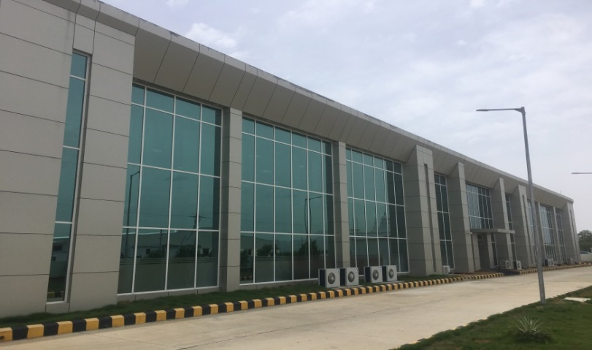
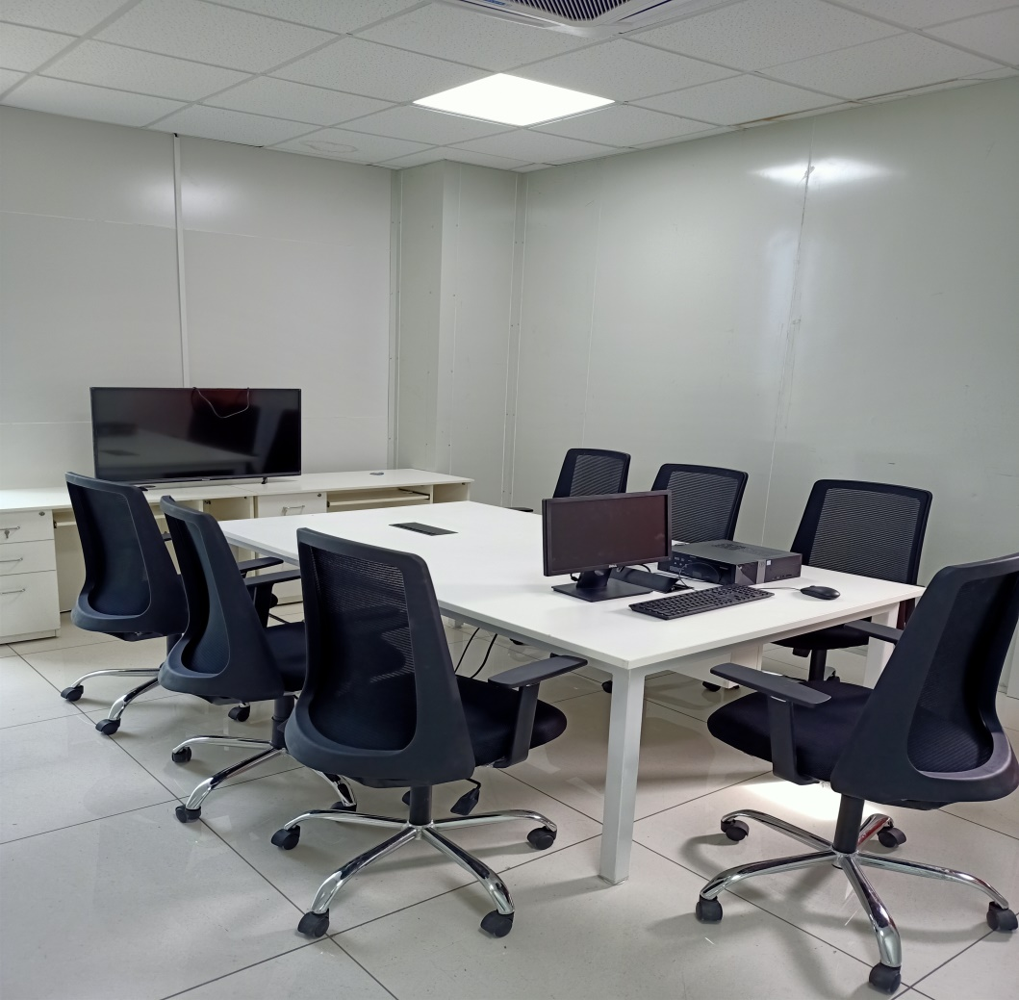
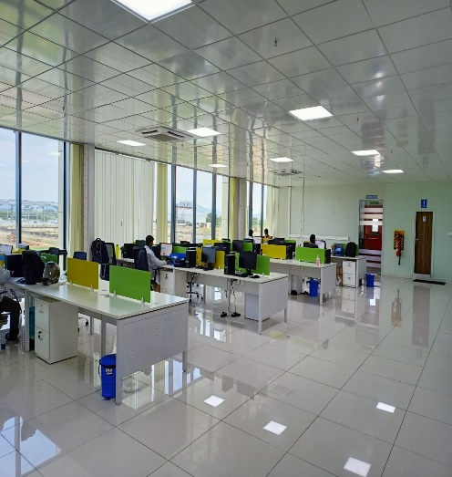
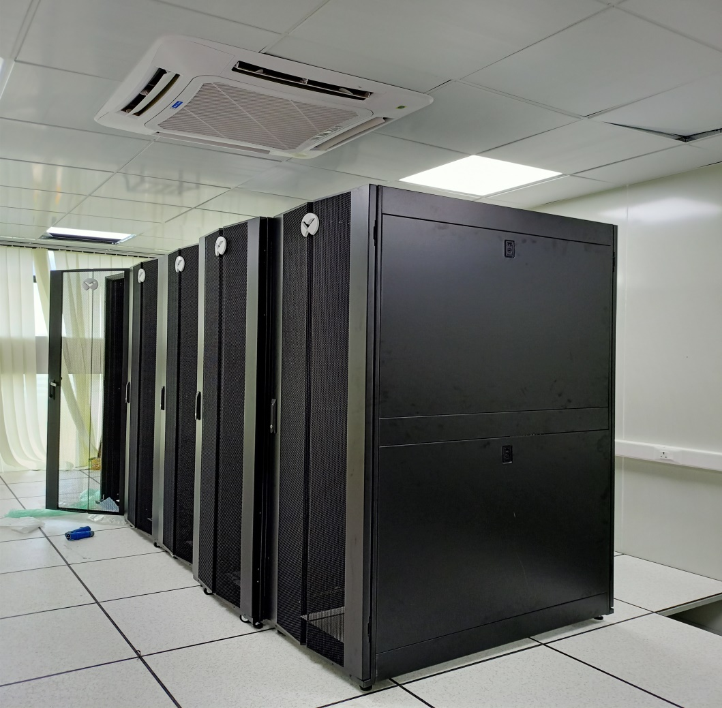
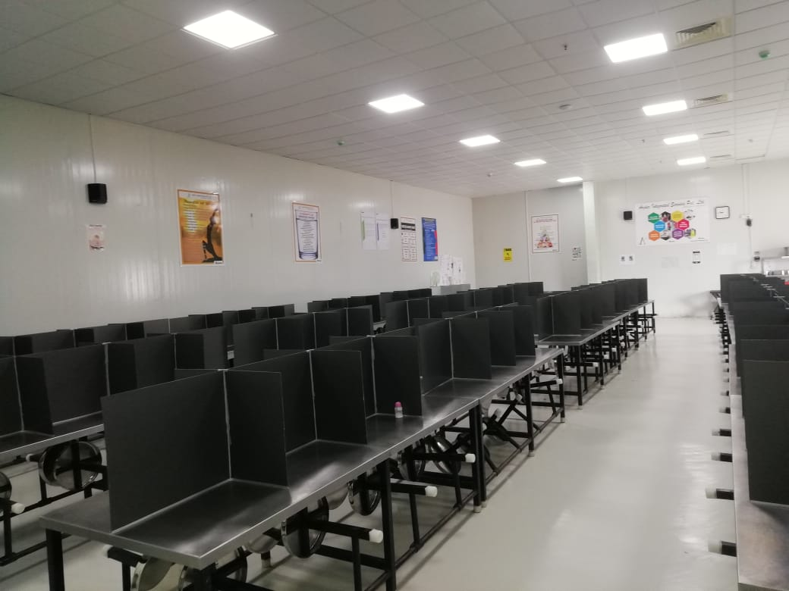
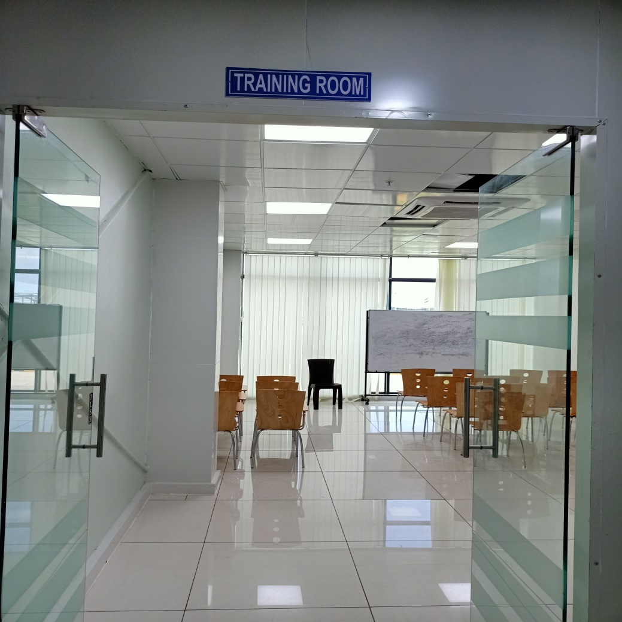
Office work place overview:
Scrolling Image
Foxlink front view
Conference room
Staff work place
Server room
Canteen
Training room

Slide 18
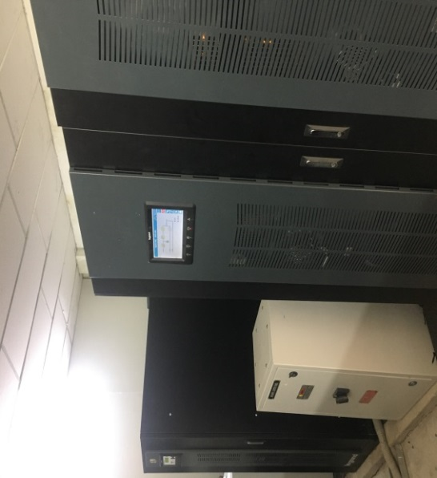
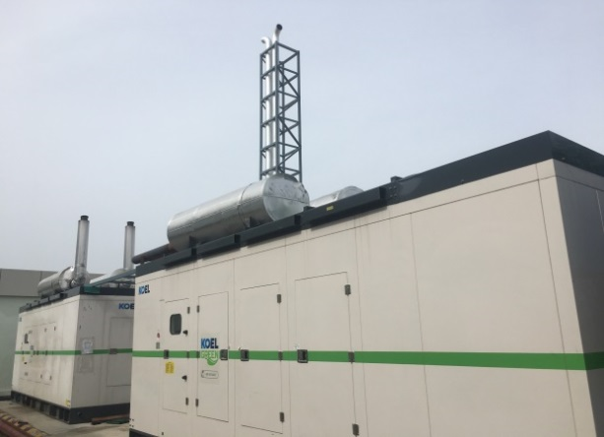
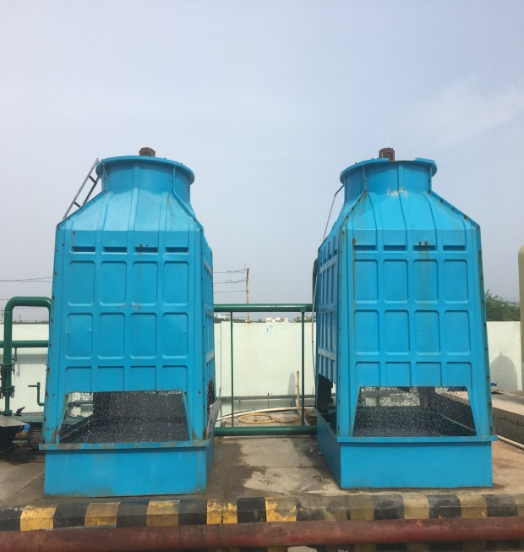
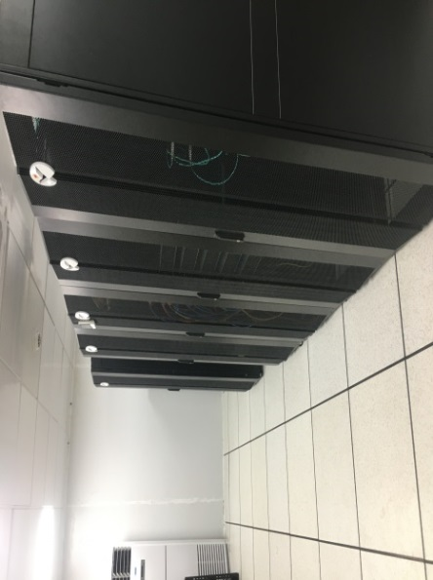
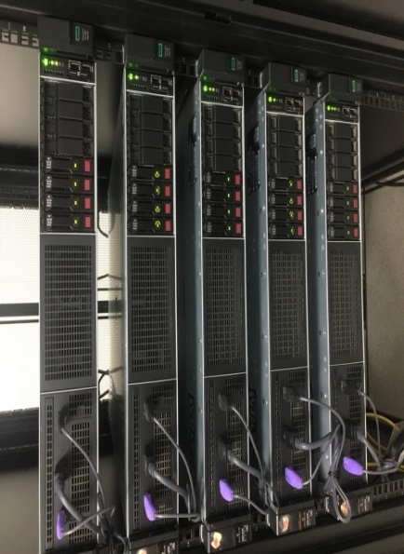
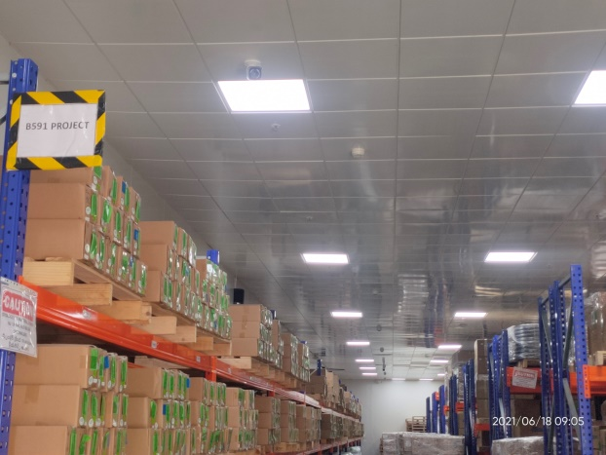
Utility facilities overview:
Scrolling Image
UPS
Power Generator
Cooling Tower
Datacenter
SFC DB & AP
Warehouse
Foxlink confidential & Proprietary

Slide 19
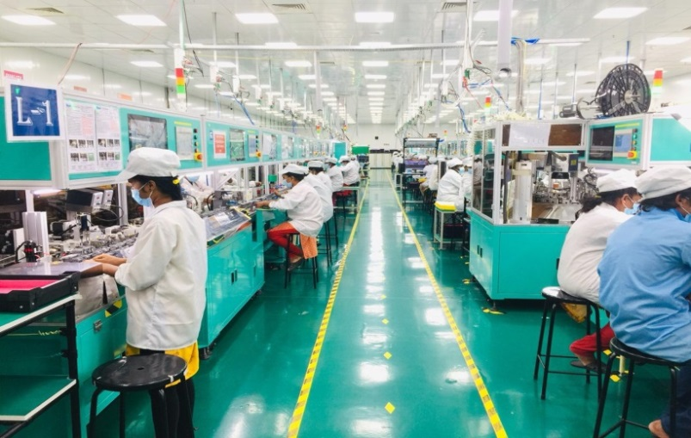
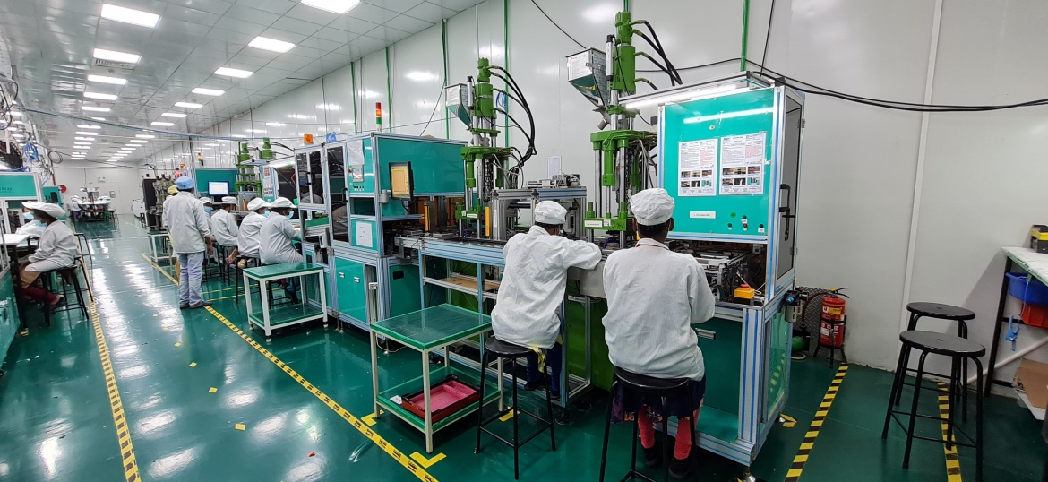
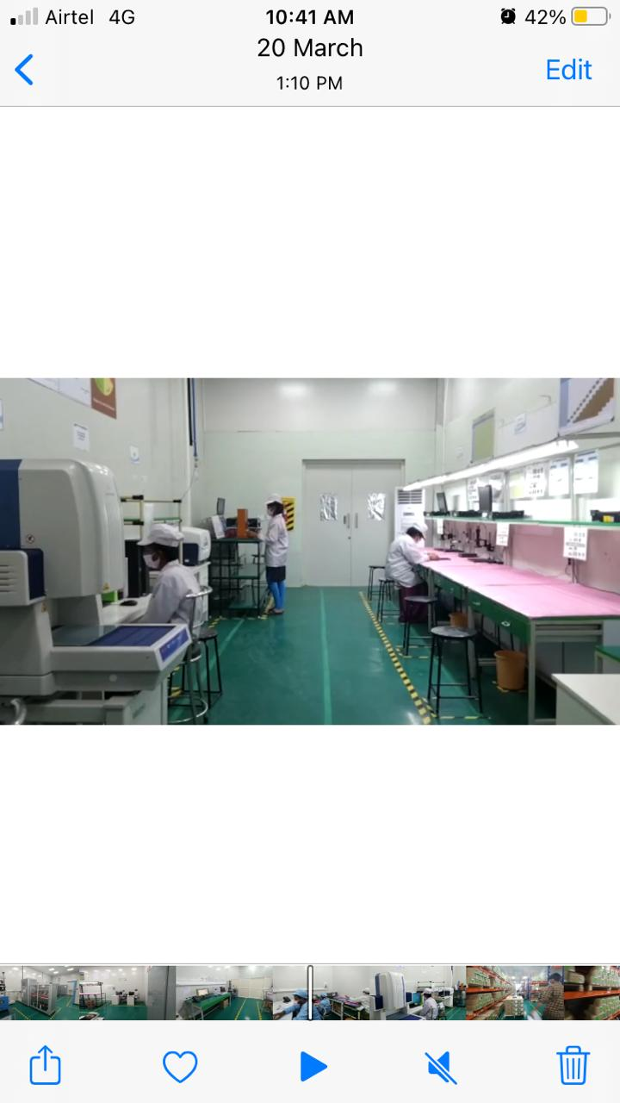
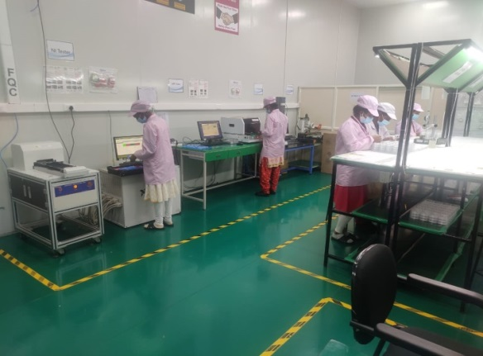
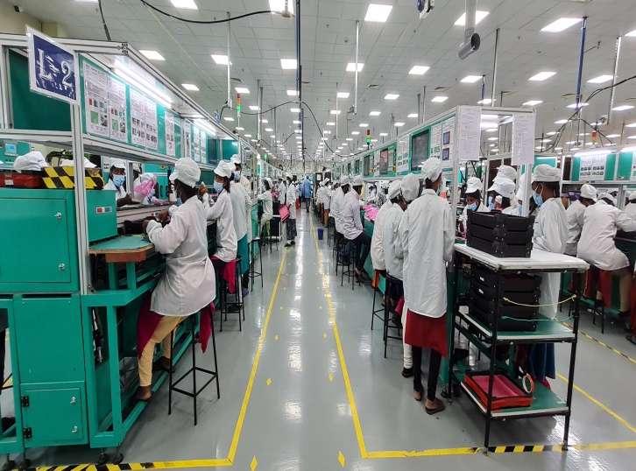
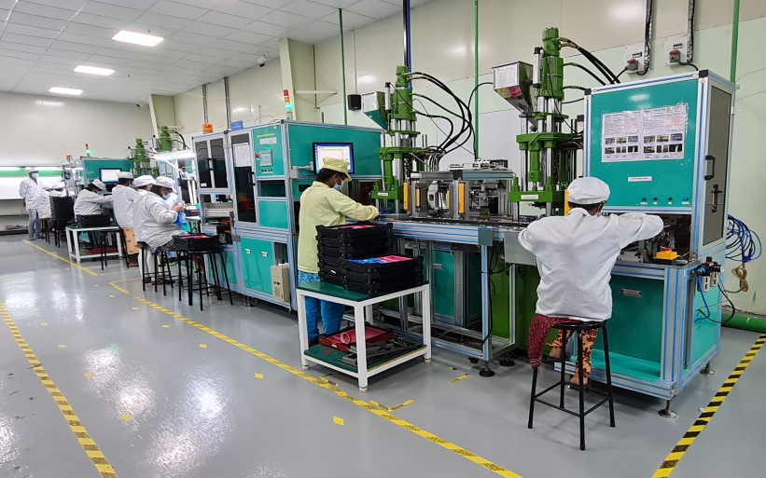
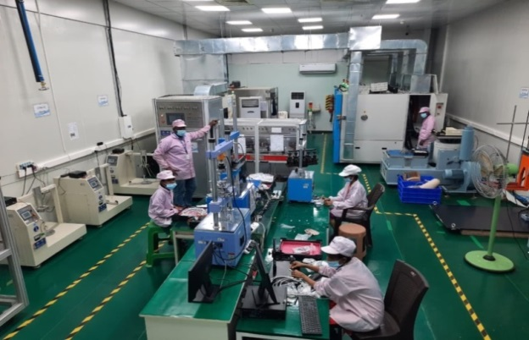
Shop-floor Cable line-Overview:
Incoming Quality control
Scrolling Image
Building A Line1 Assembly Line
Building A Line1 Molding Line
Final Quality control
Building B Line2 Assembly Line
Building B Line2 Molding Line
Online Reliability testing lab

Slide 20
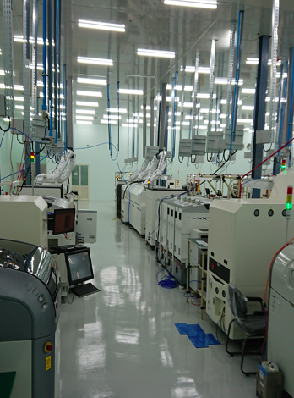
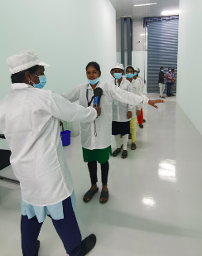
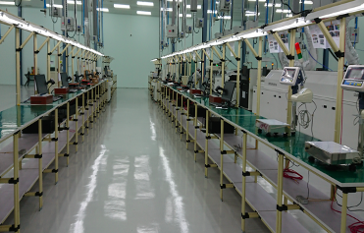
Shop-floor SMT line-Overview:
SMT line facilities:
SMT Major Equipment Capability
SMT Flow Chart ＆ 3D AOI
SMT Configurations & Capacity
Odd-Form component placement
X-Ray Inspection
Four-axis dispensing
Select Conformal Coating
Quality Assurance System (Related Certification)
Quality Assurance System (Laboratory equipment)
Traceability Management _ SFC(under plan)
Odd-Form Through Hole Component Placement
Selective Wave Soldering(under plan)
Wave Solder Configurations(under plan)
Scrolling Image
***We have 70% SMT line free capacity

Slide 21
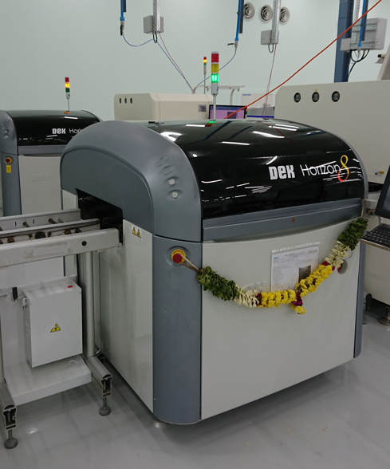
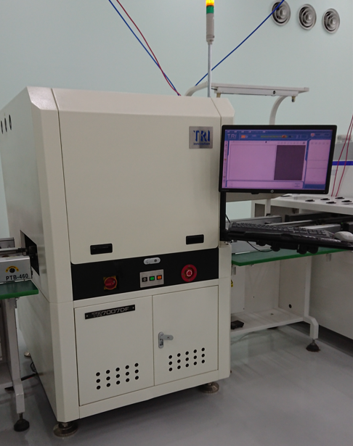
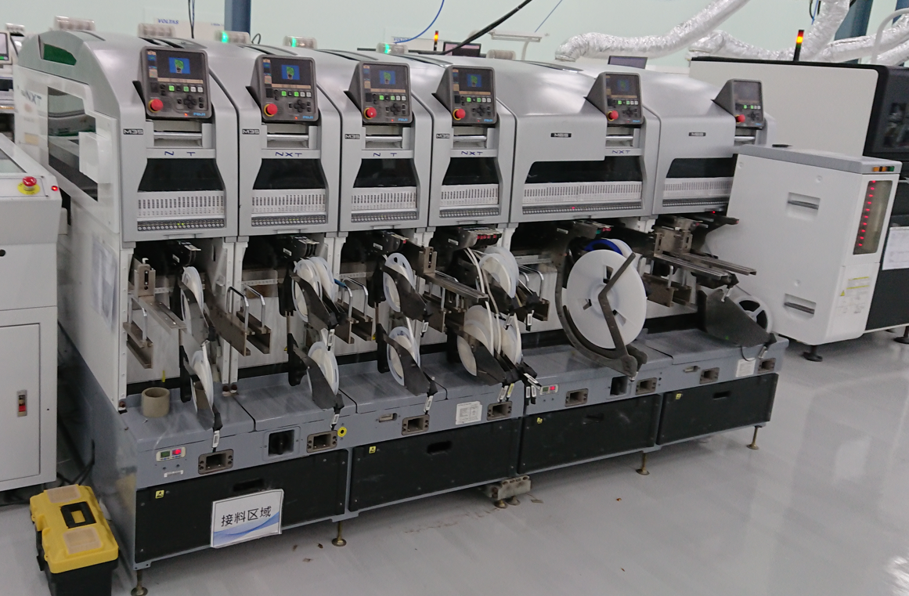
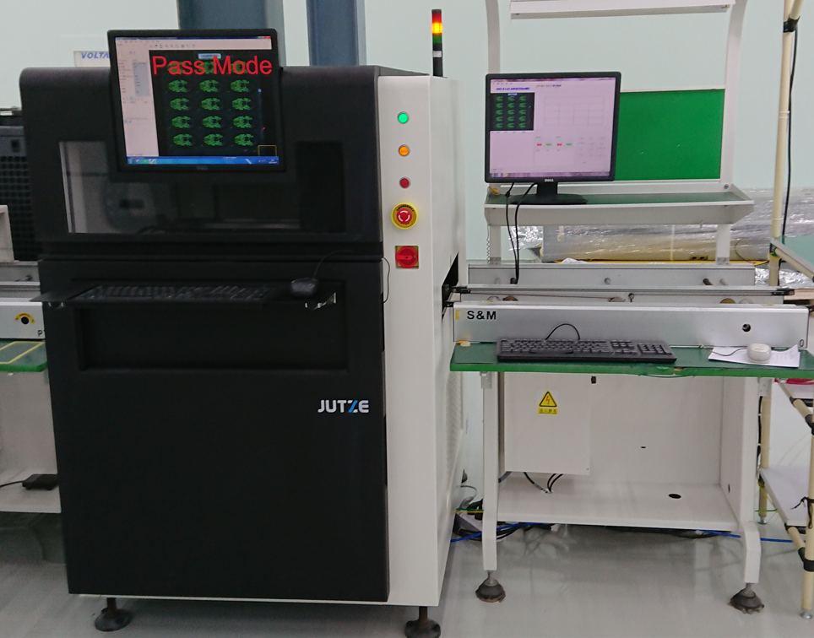
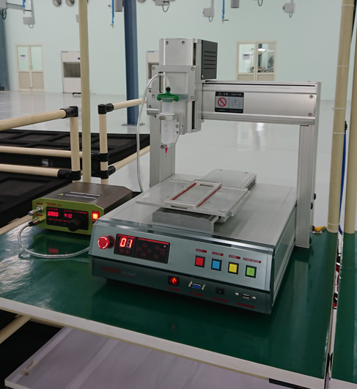
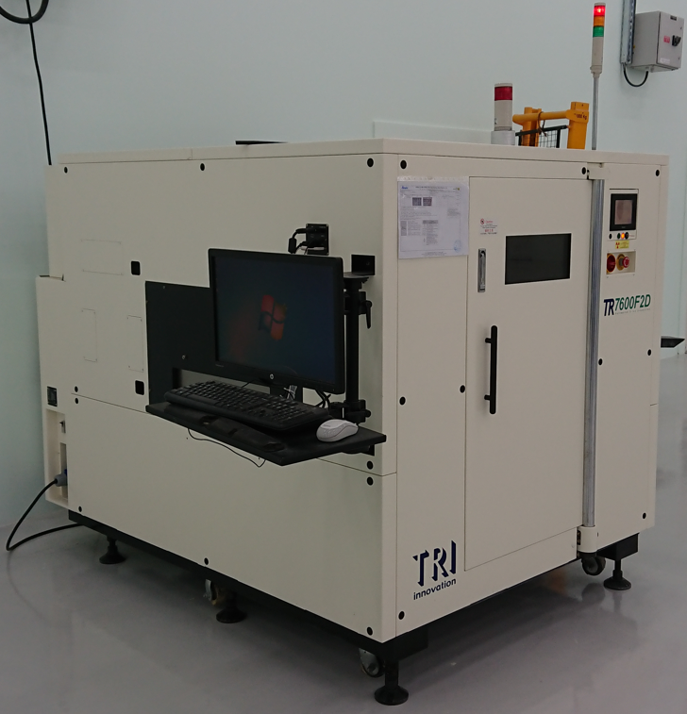
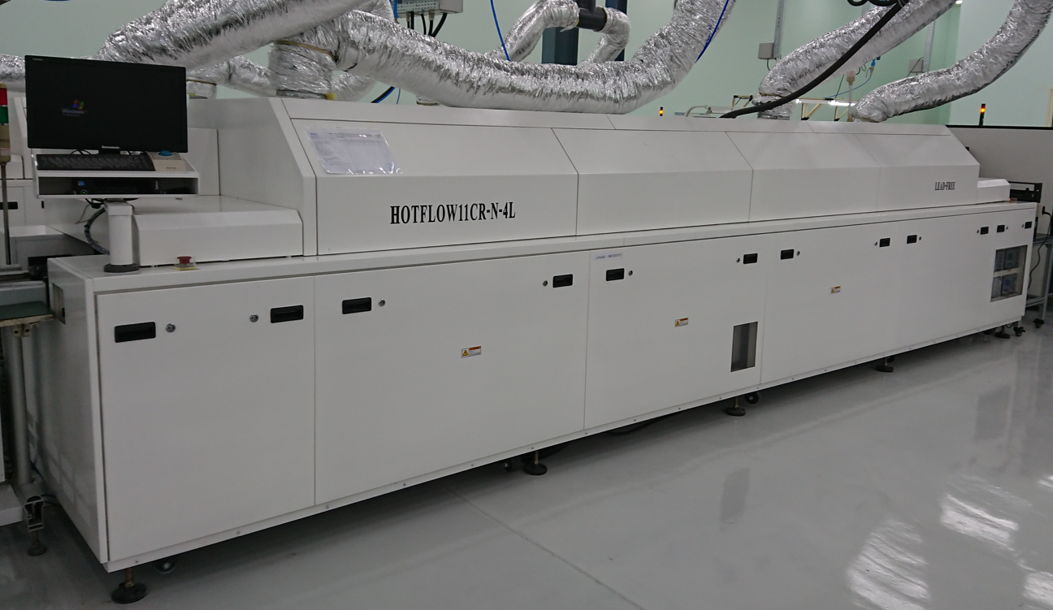
SMT Line Machine specification:
Scrolling Image
Solder Paste Printer
DEK HORIZON 08
Solder Paste Inspection
TR-7007DF
Components Mounting Machine
NXT M3 Generation III + M6 Generation III
Automatic Optical Inspection
JUTZE LI5000 (Before Reflow)
CNC PCB De-Panel Machine
X-Ray Machine
TR7600F2D
Automatic Optical Inspection
JUTZE LI5000 (Before Reflow)
Reflow
S&M HOTFLOW11CR-N-4L

Slide 22
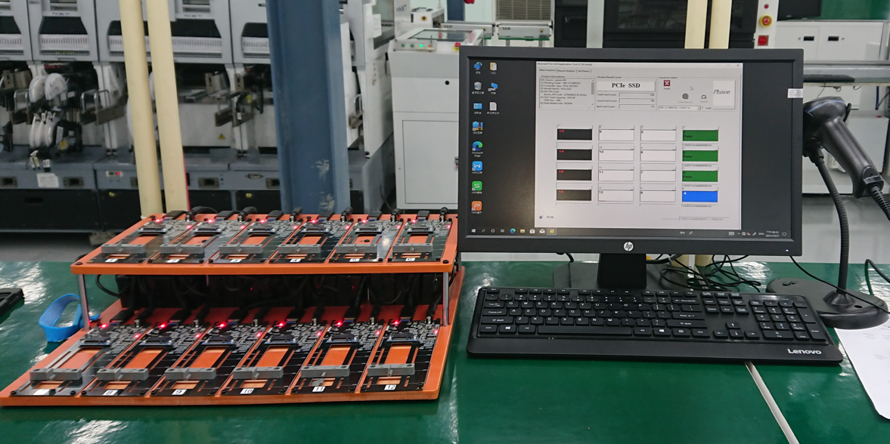
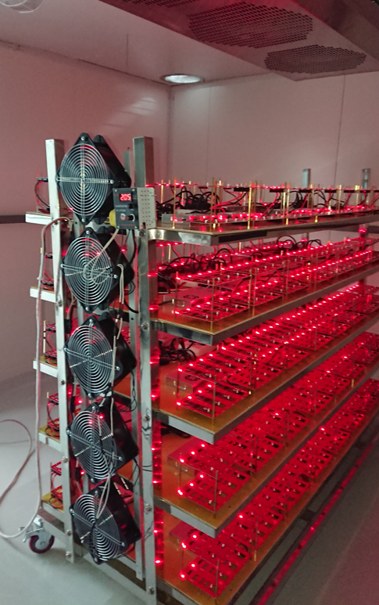
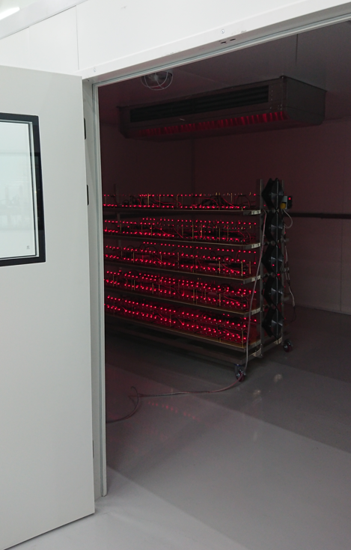
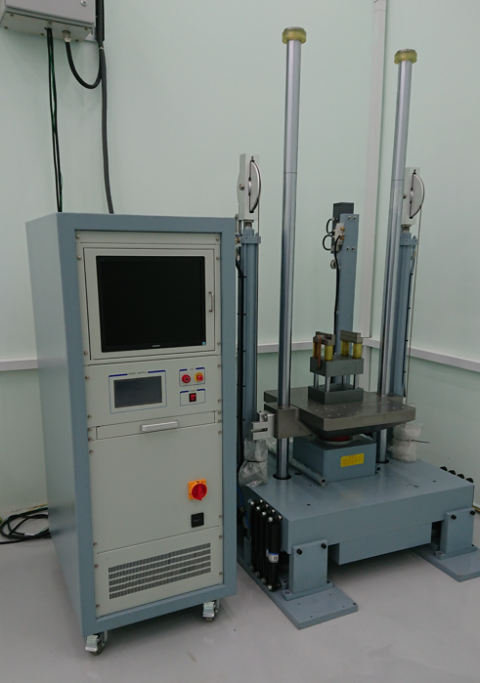
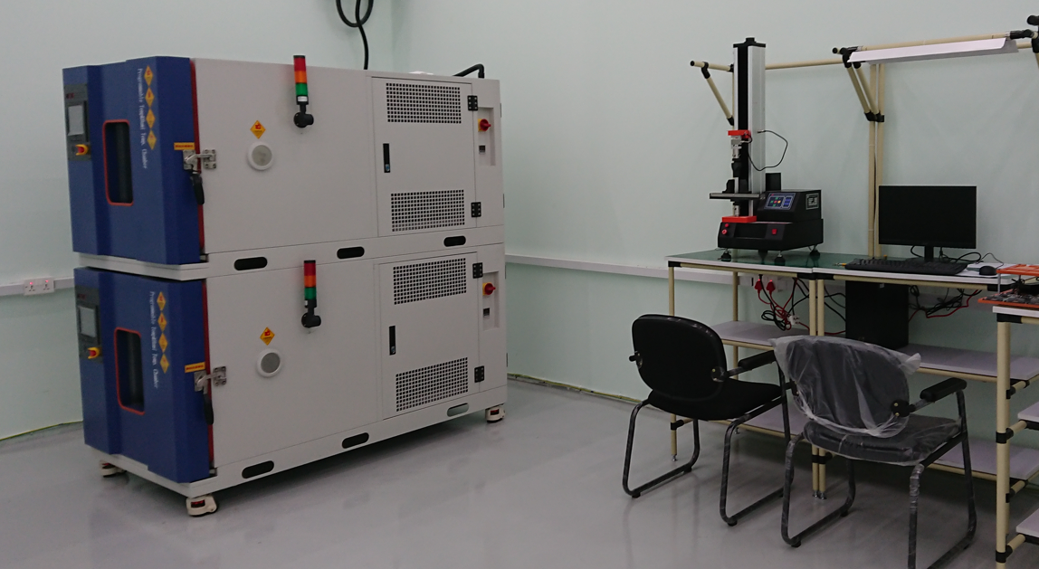
PCBA Inhouse Testing Facility:
PCB Functional Test Station
Burn-In Cart & Burn-In Room
Scrolling Image
Mechanical Shock Test
PCBA Temperature & Bending Test

Slide 23
Current Products

Slide 24
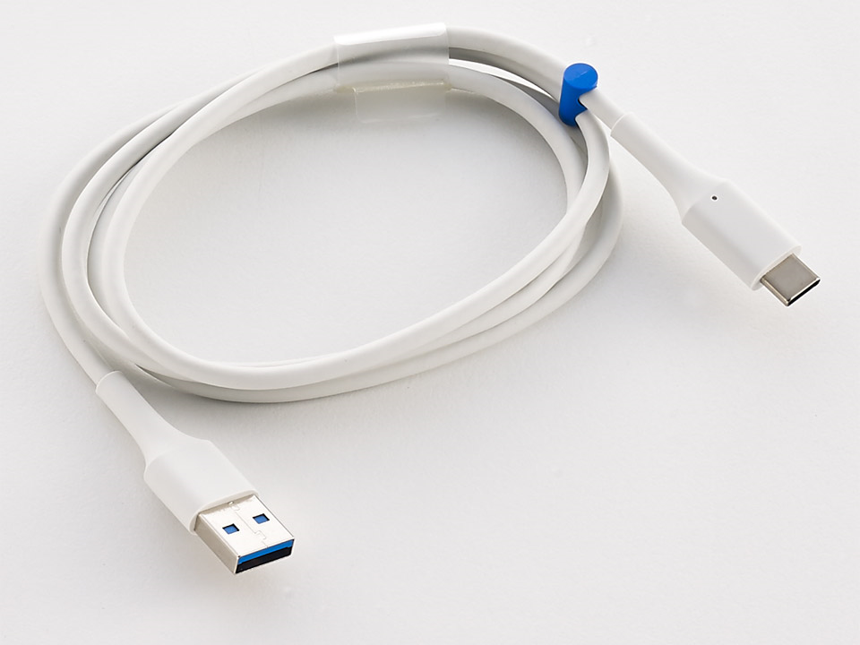
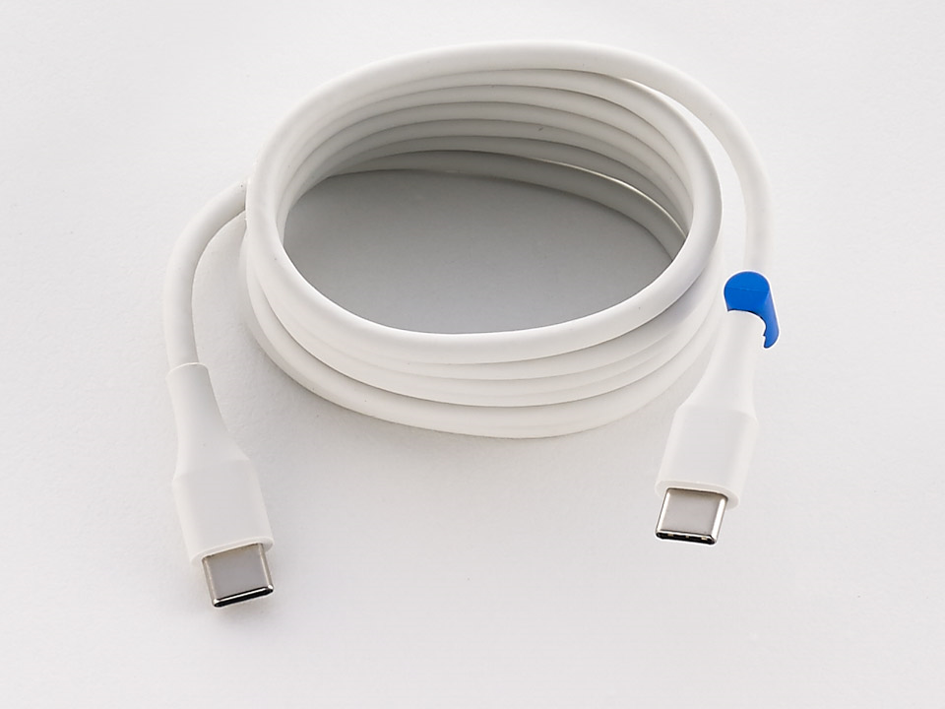
Product -Scrolling Image-3
Lightening Cable Assembly
Type C Cable Assembly
Product Description
Supports USB 3.0 at 5 Gbps high speed transmission rate
Support plug and play & hot-plug
Various lengths available supp
Product Application
Imaging device
External hard disc devices
Digital cameras
Notebooks
Gameports
Mobile phones

Slide 25
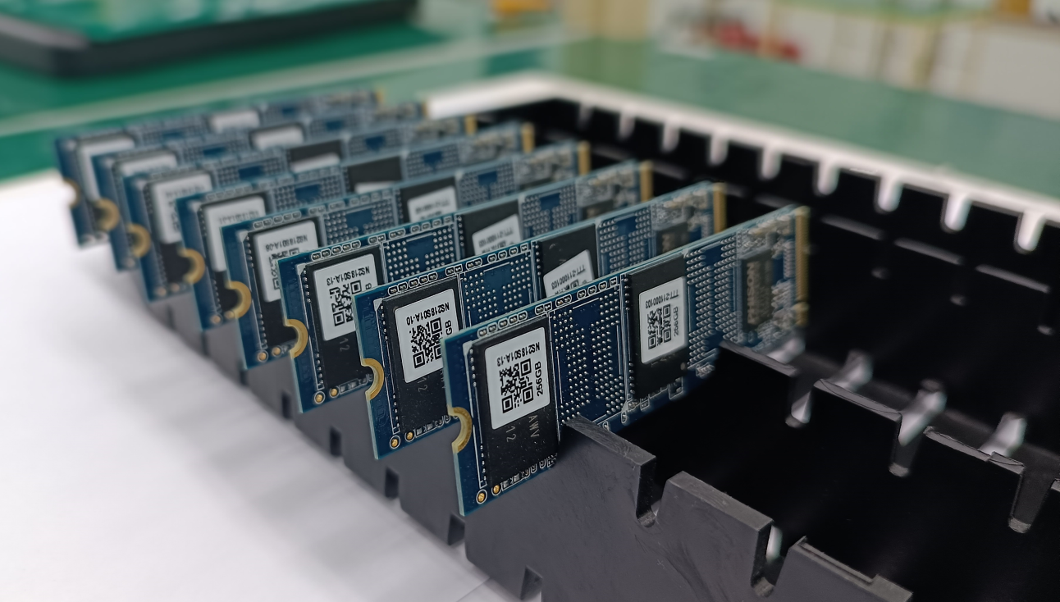
Product -Scrolling Image-1
SMT Facility
Unique features
We are the best in Top 5 EMS players in India in term of R&D capability, capacity
High End specification Machines
SMT Flow Chart ＆ 3D AOI
SMT Configurations & Capacity
Odd-Form component placement
X-Ray Inspection
Four-axis dispensing

Slide 26
Upcoming Products

Slide 27
Agenda-2
Current Products
Lightening Cable Assembly
Type C-Cable Assembly
SMT Service
Upcoming products
FATP
Wearable Device
TWS, Headphone
Power Adapter
Power Bank
Injection Molding
EV Lithium Ion Battery

Slide 28


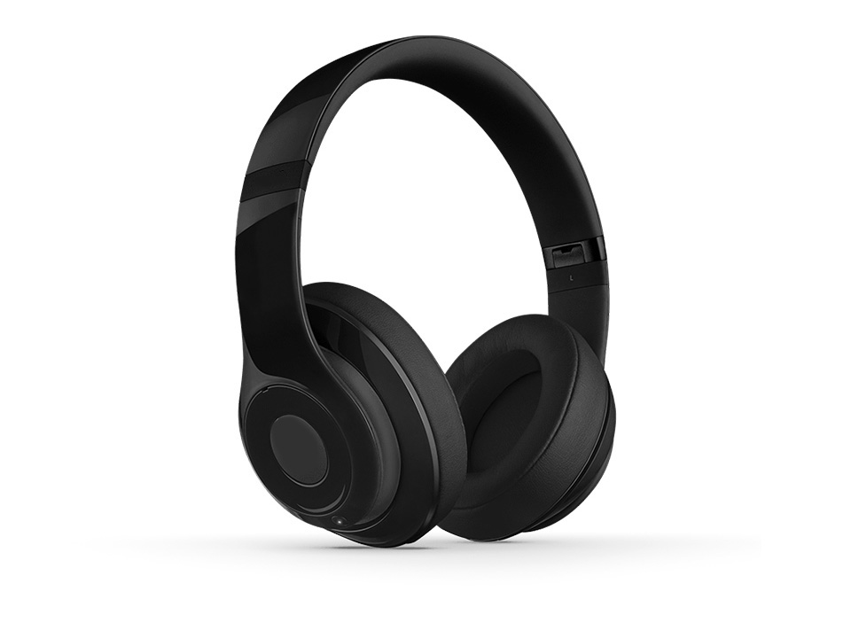
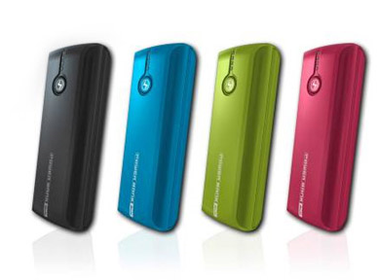
Product -Scrolling Image-1
Final Assembly, Test and Pack

Slide 29
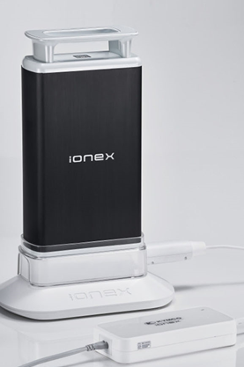
Product -Scrolling Image-2
EV Lithium Ion Battery
EV Lithium Battery specification range
Lithium Nickel Manganese Cobalt Oxide
0.6 kWh ~ 13 kWh
50.4V/70V/
NFC / IoT
Discharge: 2.9C ~ 5 C

Slide 30
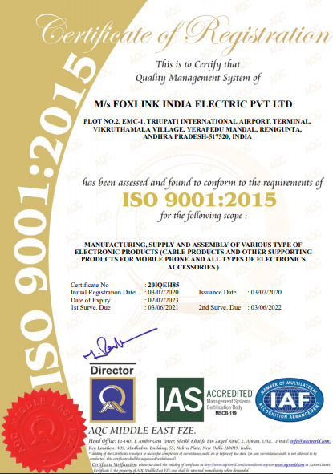
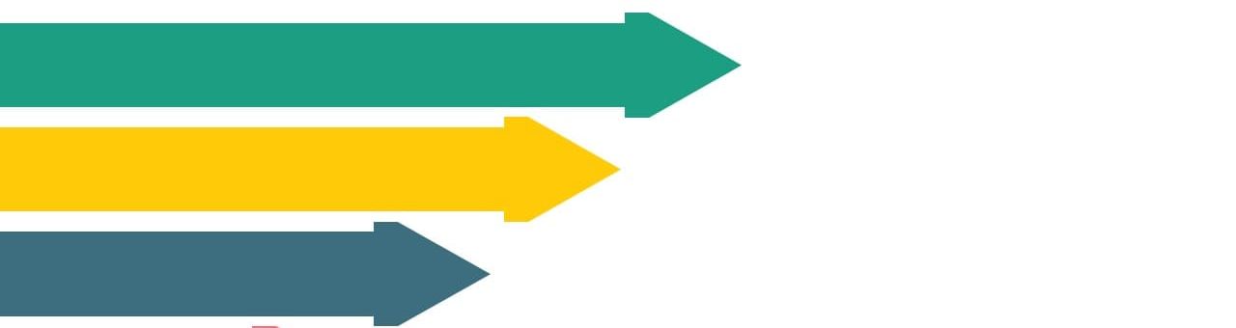
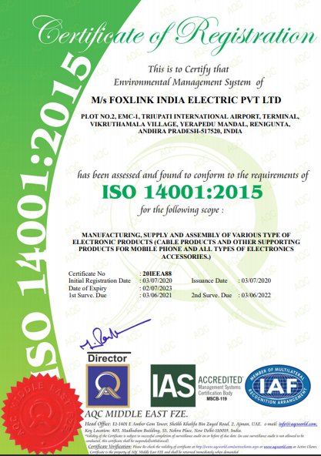

Quality certification:
ISO 9001
ISO 14001
ISO 45001
*** IATF 1649:20016 under plan with roadmap of Sep’22
Foxlink confidential & Proprietary

Slide 31

For Enquiry contact
Mohanraj Chandrababu
Sales & Marketing
Foxlink India Electric pvt ltd.,
Plot 2, EMC-1, Tirupathi International Airport Road,
Vikruthmala Village, Yerpedu Mandal,
Andhra Pradesh-517520
Mobile: 8978411259(please remove the mobile num)
Mail id: mohanraj_c@foxlink.com

